Slide 1

Data Independence in DBMS
SUVATHI.S
192571064

Slide 2
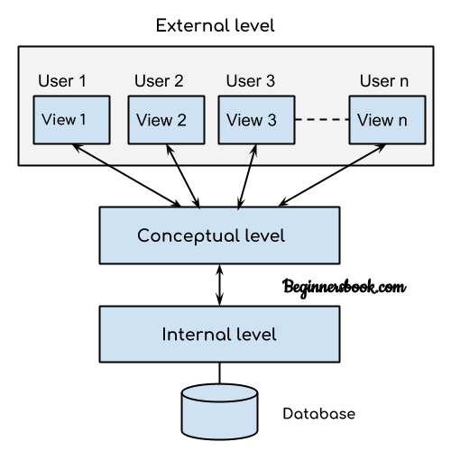
INTRODUCTION
DBMS uses a layered architecture to separate user data, logical design, and physical storage.
Data independence allows one layer to change without forcing changes in other layers.
It reduces application dependency on storage details and schema design

Slide 3
What is Data Independence?
Data independence means schema changes at one level do not require changes at the next higher level.
It is one of the key benefits of the three-schema architecture.
changes inside the database should not force programmers to rewrite application programs.

Slide 4
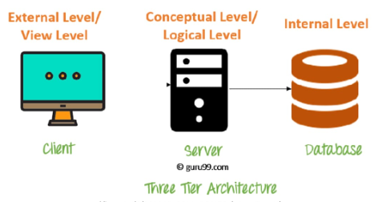
DBMS Three-Schema Architecture
External schema defines user-specific views of the data.
Conceptual schema represents the full logical structure of the database.
Internal schema defines physical storage, file organization, and access paths.

Slide 5
Physical Data Independence
You can change storage structures without changing table definitions.
Examples include changing HDD to SSD, adding indexes, or reorganizing files.
It helps improve performance without modifying application programs.

Slide 6
Logical Data Independence
You can change the logical structure of the database without changing user views.
Examples include adding a new attribute, splitting a table, or merging records.
It is important when business requirements evolve over time.

Slide 7
Significance in DBMS Architecture
It supports modular database design by separating concerns at different levels.
It reduces maintenance cost when schema changes occur.
It improves flexibility, scalability, and long-term system stability.

Slide 8
Functions
It supports schema evolution without rewriting all application code.
Makes it easier to modify, update, and maintain the database.
It allows DBAs to tune performance while keeping the logical model stable.
Multiple users and applications can access the same database independently.

Slide 9
Real time application
Banking Systems Update customer records without affecting banking applications.
E-Commerce Platforms Add new products and categories without changing the shopping app.
Hospital Management Systems Add new patient or medical records without affecting hospital software.
University Management Systems Add new courses, subjects, or student details without changing existing portals.
Railway Reservation Systems Add new trains and routes without affecting ticket booking.

Slide 10
Case Study
E-Commerce Website
Example: Amazon, Flipkart
Products are added or removed every day.
Product tables may be split into separate tables for specifications, reviews, and pricing.
Customers can still browse and purchase products normally.
Data Independence Used:
Faster search using indexing.
Database restructuring without affecting the shopping app.

